Slide 1


Slide 2

WELCOME
WELCOME
WELCOME

Slide 3
the mathematics of collective behavior

Slide 4

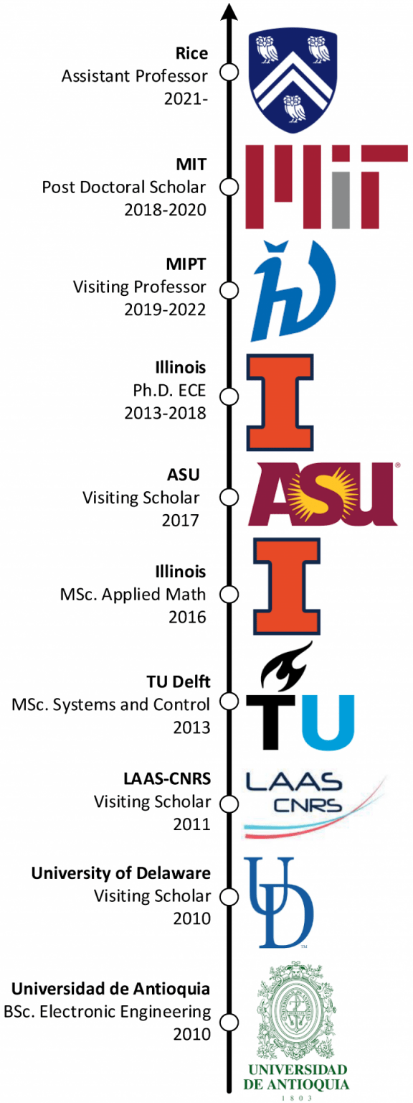
Who am I?
César A. Uribe
Louis Owen Assistant Professor
Department of Electrical and Computer Engineering
Office: Duncan Hall 2048
Undergraduate Teaching:
ELEC 303 – Random Signals
ELEC 570 – Decentralized Machine Learning

Slide 5

Plan for Today
A 10 min introduction to mathematical analysis of collective behavior
Objectives:
Understand commonalities of distributed systems
Recognize the need for decentralized analysis in modern engineering systems
Participate in one exercise of collective behaviors and rationality study

Slide 6
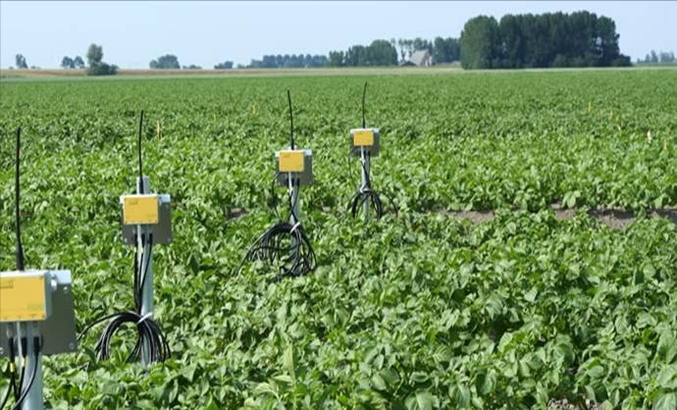
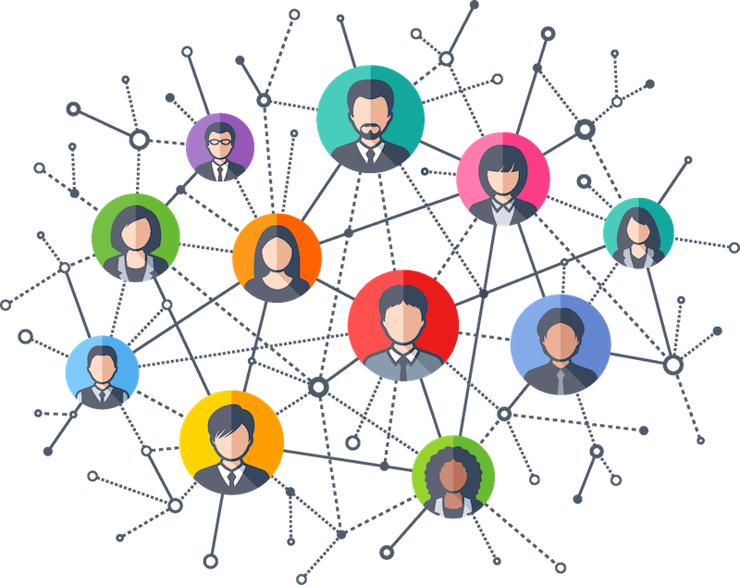
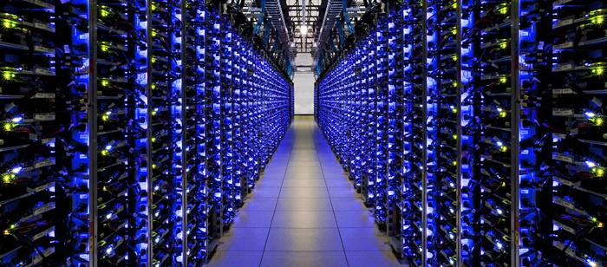

Slide 7
Characteristics
Many components/units (we call them agents).
Connected over networks.
Cyber and Physical interactions.
Challenges
Decentralization: Distributed computations.
Scalability: Price of decentralization.
Optimality: Efficiency & Performance.

Slide 8
How to approach complexity?

Slide 9
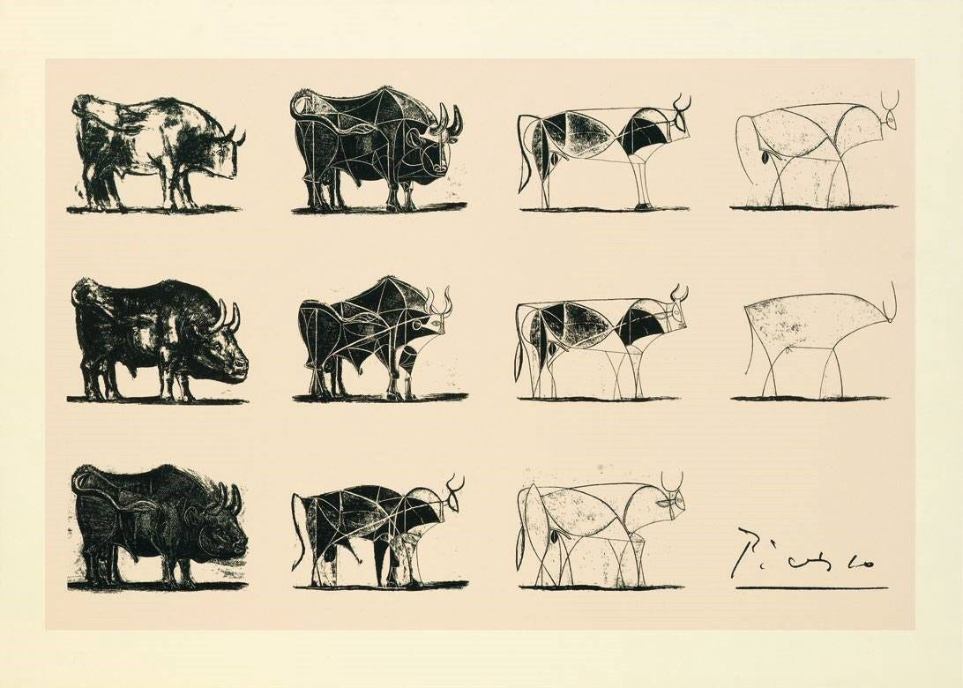
How to approach complexity?

Slide 11
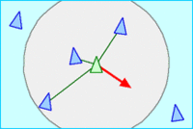
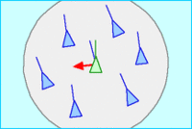
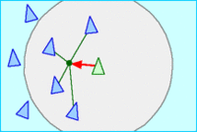
complexity arises from simple rules
separation
alignment
cohesion

Slide 12
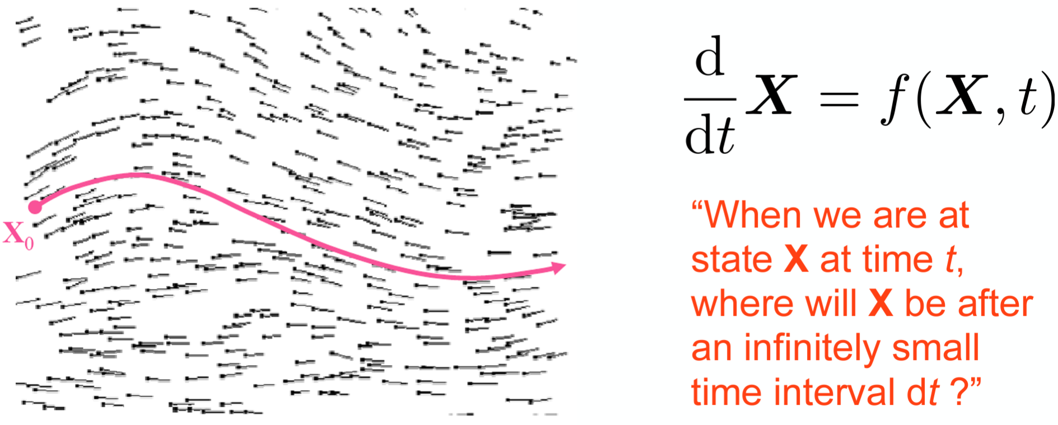

mathematical modelling: predicting the future is harder than predicting the past

Slide 13

demo
https://eater.net/boids

Slide 14

an exercise on collective behavior

